Slide 1
Analyze George’s story!

Slide 2
Using the messages…
Repair strategies (Meyer & Rothenberg, 2004)
  Apologize -
  Change Subject -
  Deny -
  Excuse -
  Justify -
  NV Reaction -
  Offset Harm -
  Silence -

Slide 3
Typologies exist to describe – but which work to address hurtful messages? (Dunleavy & Dougherty, 2013)
Identification -
NV Affirmation -
Behavioral Alteration -
Taboo Topics -
Triviality -
Ineffective Repairs -
Notes:
Qualitative Research Reports in Communication
Volume 14, Issue 1, 2013
Select Language​▼
Translator disclaimer
Marital Partners' Perceptions of Effective Message Repair
View full textDownload full textFull access
DOI:10.1080/17459435.2013.835341 Katie Neary Dunleavy^{a*} & Kelley Dougherty^{b} pages 44-52
Typologies exist for both hurtful messages and repair strategies. The typologies help relational partners reconcile problems that arise in relationships, but it can be challenging to know when the problem is truly resolved. The purpose of this study was to examine the perception of the effectiveness of attempts at repair. One hundred thirty-one currently married individuals provided qualitative data to explain how they knew the marriage progressed after a hurtful message. Six categories emerged from the data: identification, nonverbal affirmation, behavior alteration, taboo topics, triviality, and ineffective repairs.

Slide 4
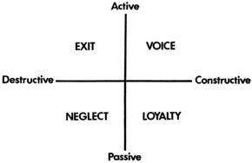
Exit-Voice-Loyalty Neglect (EVLN) Model

Slide 5
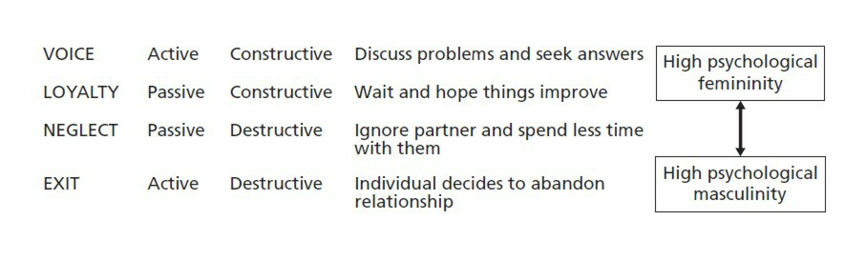
EVLN Findings
Infidelity study (Weiser & Weigel, 2014)
  Destructive comm increased w/ seriousness of infidelity
Notes:
From the work of Caryl Rusbult, Isabella Zembrodt & John Iwaniszek - graphic copyright © 2001 Psychology Press Ltd
Communication Quarterly Volume 62, Issue 4, 2014 Testing a Model of Communication Responses to Relationship Infidelity DOI:10.1080/01463373.2014.922482 Dana A. Weiser^{a*} & Daniel J. Weigel^{b} pages 416-435

